Slide 1

Cafe Table Reservation System

Slide 2
Developed By:-
Narige Navya
Pasupuleti Vinay Kumar
Shalini C
Sidde Bharath Kumar Reddy
Akshatha N R
B R Rachitha Jain
Jadhav Dinesh
Manike Anusha

Slide 3

ABSTRACT
The Cafe Reservation System is a comprehensive software solution designed to streamline and enhance the process of making reservations at cafes, coffee shop.
This project aims to provide customers with a user-friendly platform to reserve tables, order food and manage their dining experience efficiently.
Cafe owners and staff will also benefit from improved management tools to handle reservations, track customer preferences, and optimize overall operations.

Slide 4

INTRODUCTION
The Emergence of the Café Table Reservation System
Seamless Integration of Technology
Transforming the Interaction Between Cafes and Customers
Addressing Challenges of Traditional Booking
Elevating Customer Experiences
Convenience, Efficiency, and Enhanced Service

Slide 5
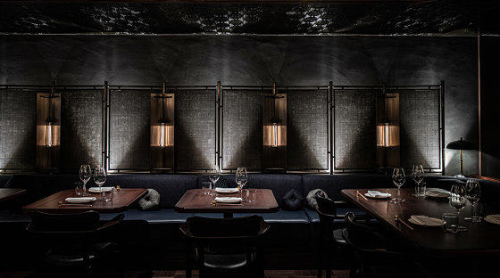
PROPOSED SYSTEM
Proposed System
Online Reservation Portal
Real-time Availability
User Accounts
Notifications
Reservation Management for Café Staff
User Feedback and Reviews

Slide 6

PORTALS
ADMIN
USER

Slide 7

ADMIN
Login to Portal
Create Admin Account
Add or remove new delicacy to the menu and to read
from the contact-form.
Edit delicacies from the menu card details like item name, price, and description tTo keep the food item information updated with the current prices.
Enable or disable the food items in the cafe.

Slide 8

USER
Register into the application.
Sign into the application to maintain the record of activities.
Change Password
Update Profile
Search for table based on the search keyword.
Apply filters and sort results based on different categories of the tables available. (AC room table/ non-AC room table).
Add all the reserved tables and customize the reservation at the end.
Experience a seamless online reservation process.
Receive a reservation confirmation summary page once done with the reservation.

Slide 9

TECHOLOGIES USED
TECHNOLOGIES USED
HTML
CSS
BOOTSTRAP
SPRINGBOOT
MYSQL
ANGULAR
POSTMAN

Slide 10

ER-Diagram
Change Password
New user Registration
Admin home
Update Profile
Logout
User
View / search menu
Add tables
Admin
Login
Search Tables
Admin Register
Add menu
Logout
Reserve Table
Update menu
User Register

Slide 11

Advantages
Convenience
Flexibility
Real-time Availability
Special Requests
Online Reputation
Marketing Opportunities

Slide 12

Modules of Cafe Table reservation system
User Module
Admin Module
Table Module
Menu Module

Slide 13
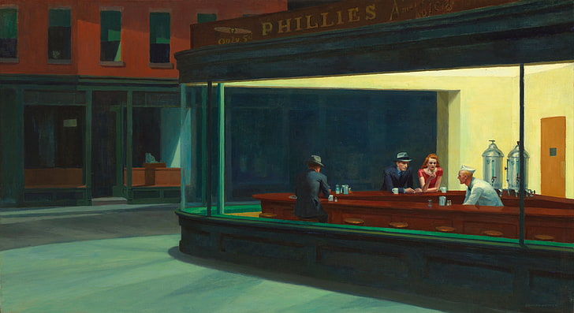
USER MOULE
The journey begins with user registration, where customers can create their accounts by providing essential details such as name, email, mobile number, and password.
Once registered, users can easily log in using their credentials. The login process offers a secure gateway for customers to access the module's features, includes Viewtables,SearchTables,aboutus,Gallery,logout,Home etc.

Slide 14
Data Privacy Assurance
Users have the freedom to update their profile information whenever needed. Whether it's a change in contact details or preferences, the module ensures that customers can effortlessly maintain accurate and up-to-date information.
At the end of their interaction, users can securely log out from their accounts. The logout feature ensures that customer information remains protected and prevents unauthorized access to their accounts

Slide 15
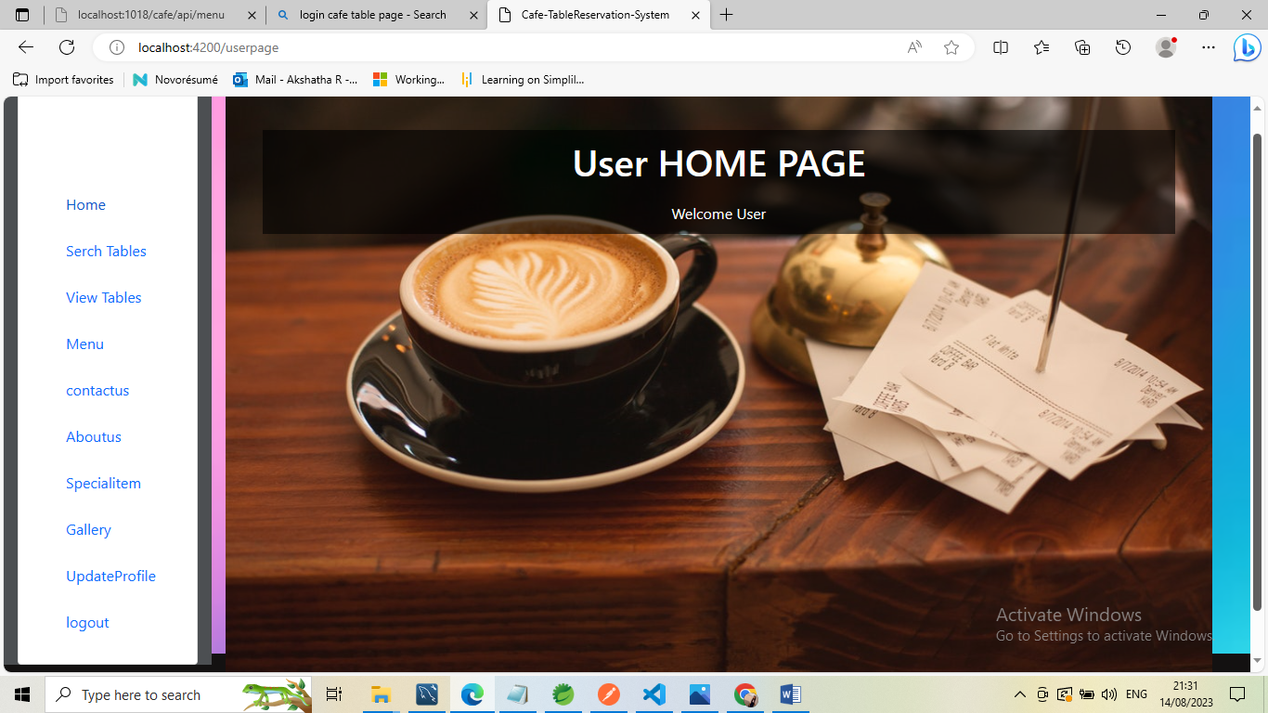
USER OUTPUTS

Slide 16
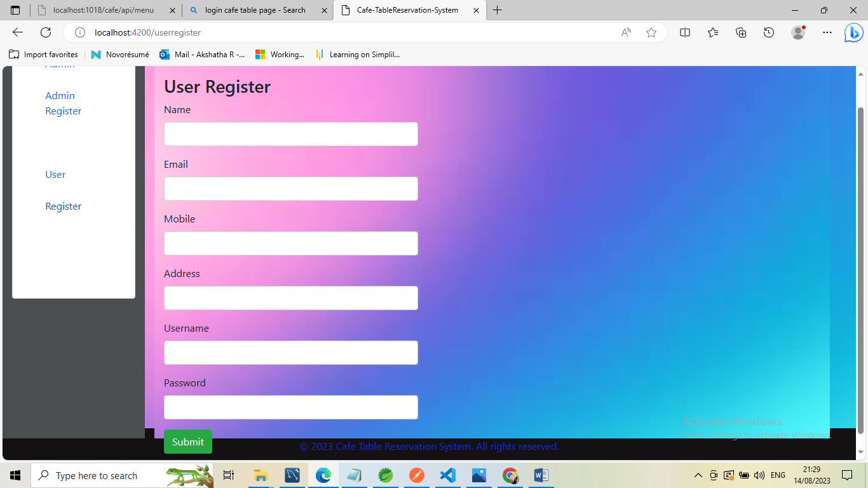

Slide 17
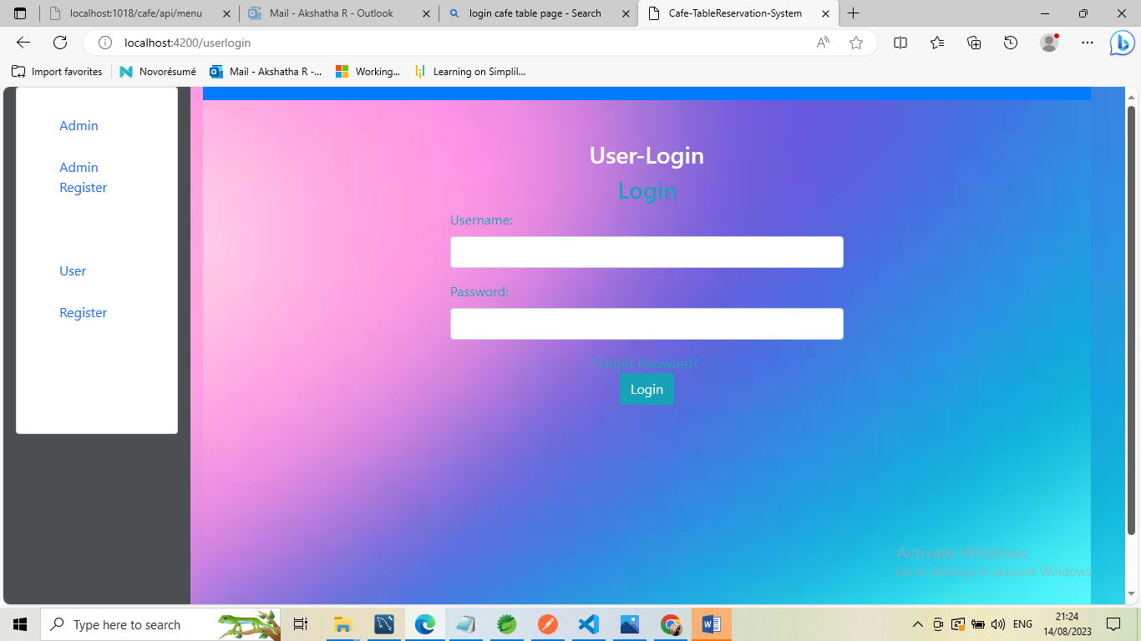

Slide 18
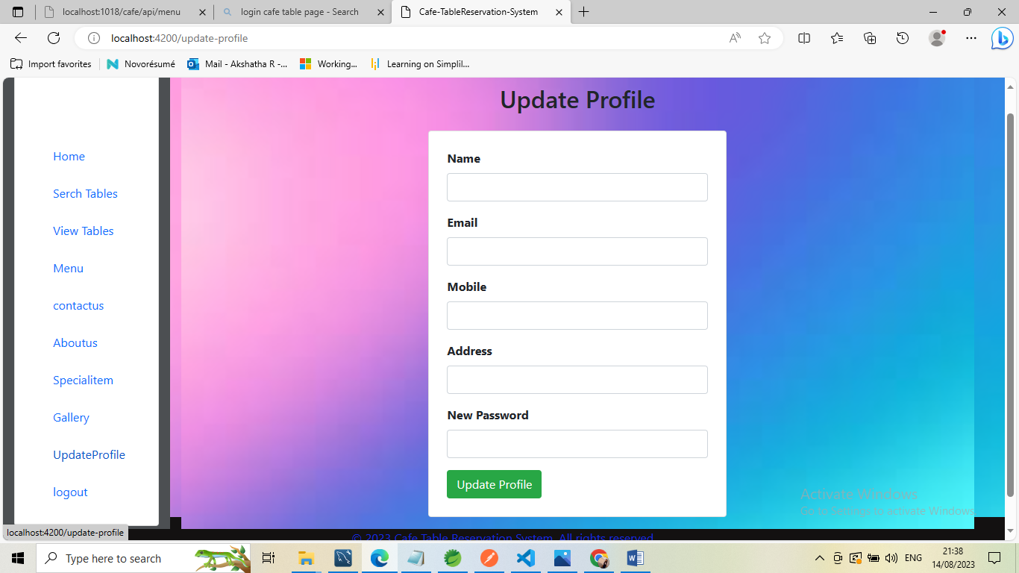

Slide 19

ADMIN MODULE
Admin Register
Allow new administrators to register with the system by providing their details, such as a unique username, email address, and password. After successful registration, they can access the admin interface.
Admin Login
Admins can log in using their registered credentials. This authentication step ensures only authorized personnel can access the admin features.
Home
The admin's home dashboard can display key information about current reservations, upcoming events, and any outstanding tasks. This dashboard provides a quick overview of the system's status.

Slide 20
Reservation Management:
Admins can view and manage reservations in the system. They can see a list of all reservations, search for specific reservations, edit reservation details, or cancel reservations if necessary.
Table Management:
This section allows admins to manage tables within the establishment. They can add new tables, specify seating capacities, update table statuses (e.g., available, reserved, occupied), and even arrange tables for events or busy periods.
Add Tables:
Admins can add new tables to the system. They input details such as table number, seating capacity, and location within the establishment. This helps maintain an accurate representation of the restaurant's layout.

Slide 21
Menu Management:
Admins can manage the menu available for reservations. They can add new dishes, update existing ones, set prices, and define special offers or seasonal items.
Logout:
Provide a secure logout mechanism so admins can end their session. This prevents unauthorized access to admin privileges.

Slide 22
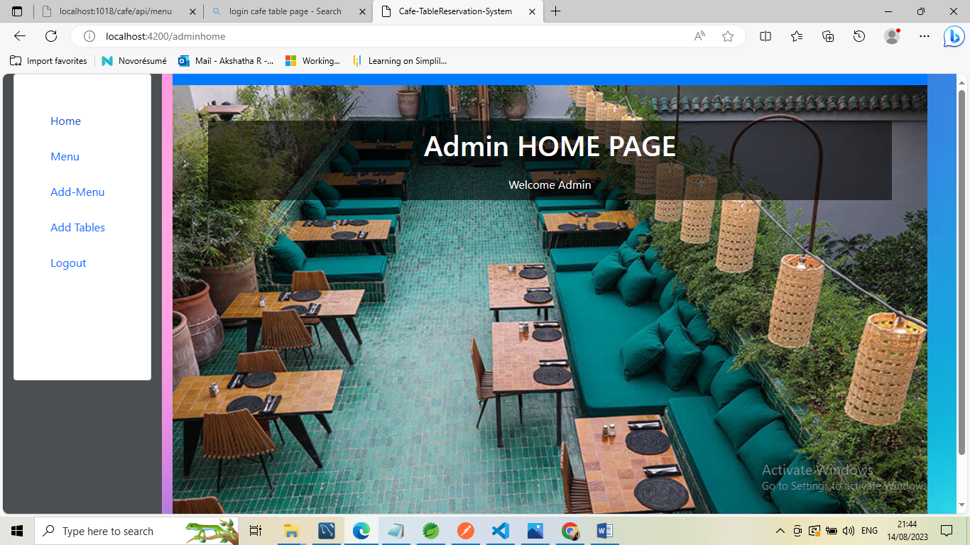

Slide 23
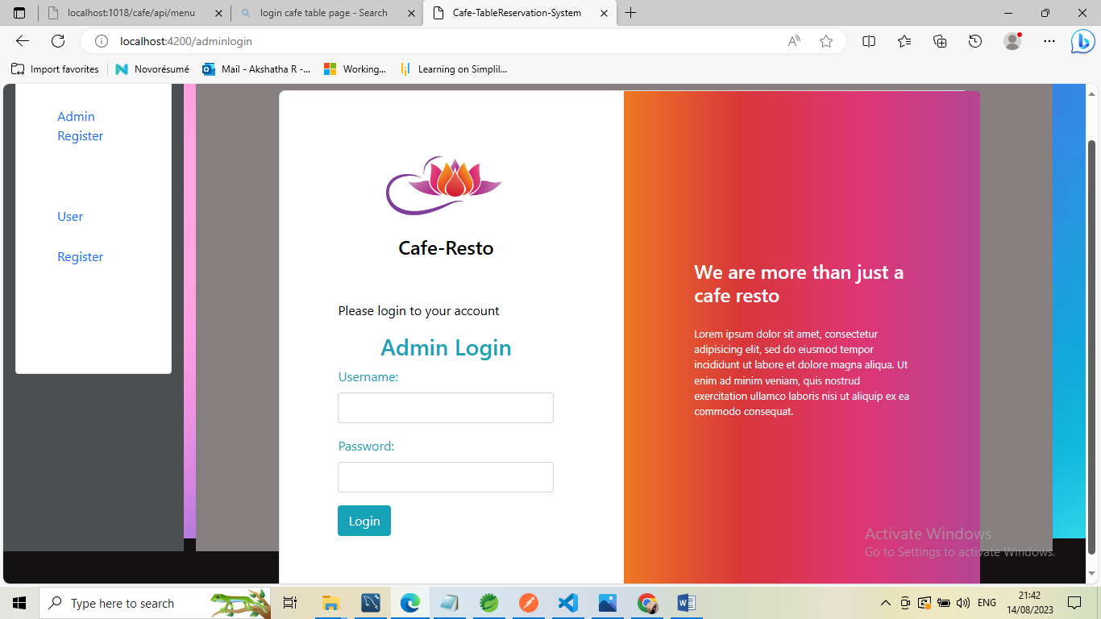

Slide 24
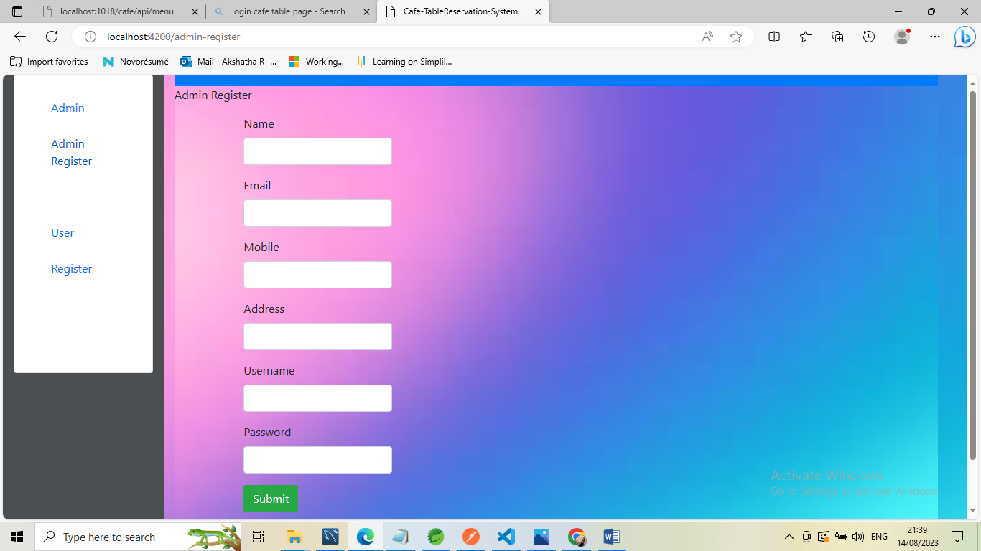

Slide 25


TABLE MODULE
Search Table
Access the Search Functionality
Apply Filters
View Table
Select Table to View
Visualize Data
Add Table
Input New Data
Review and Confirm

Slide 26
Purpose of the table module's features
SEARCH TABLE
VIEW TABLE
ADD TABLE
PURPOSE
BENFIT
USAGE

Slide 27
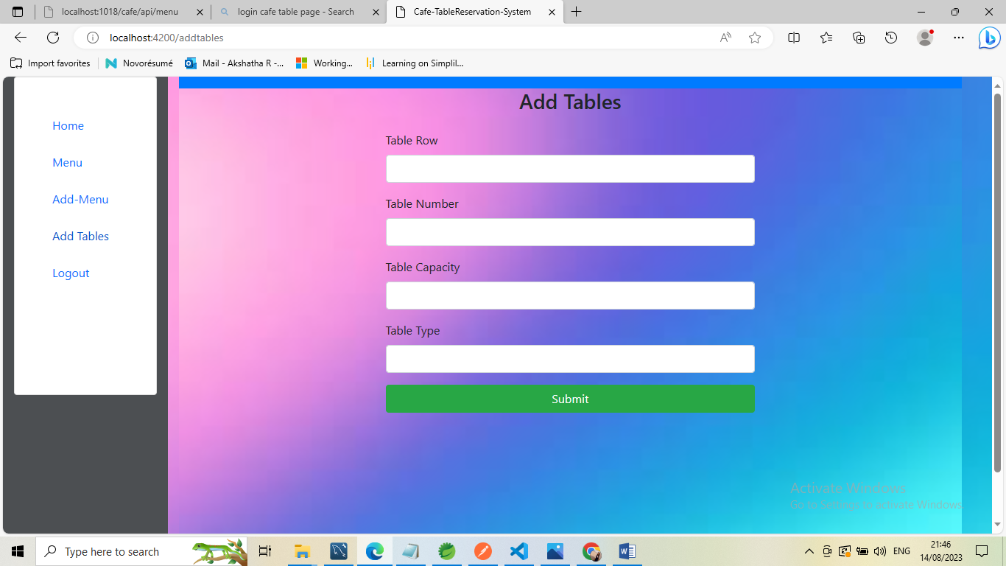

Slide 28
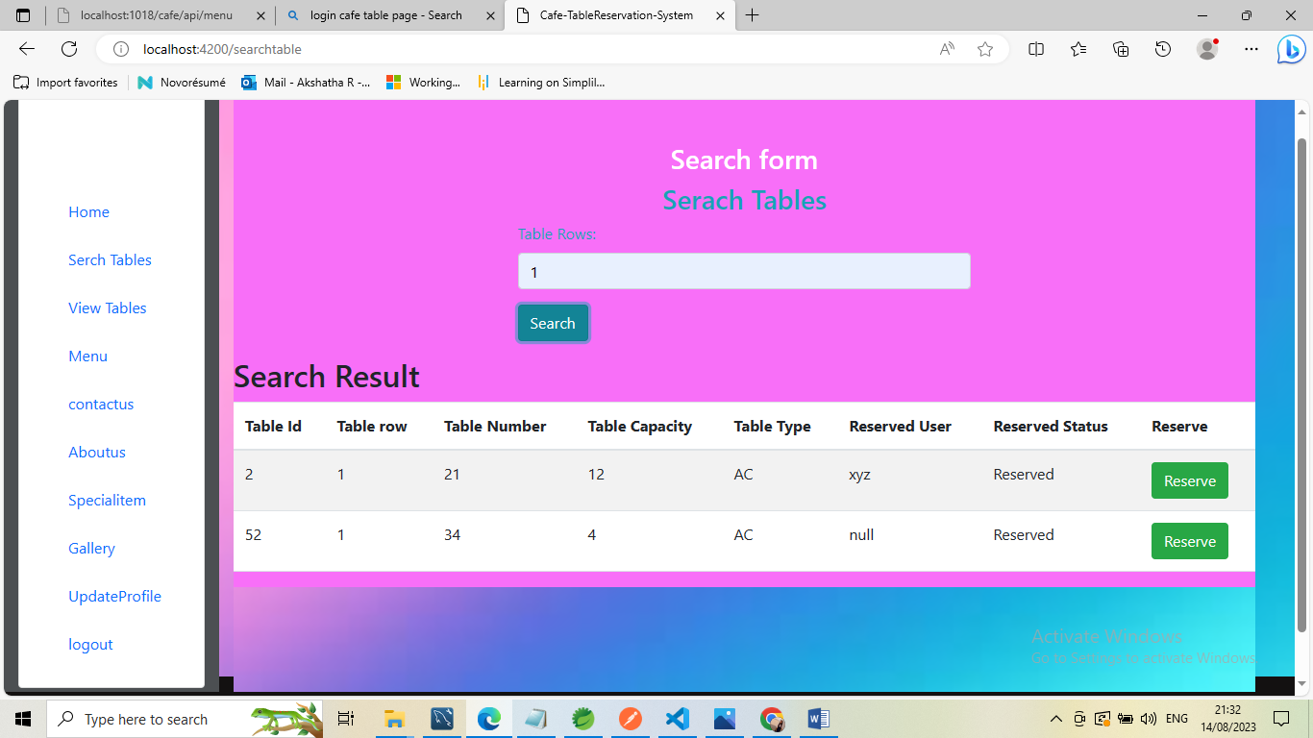

Slide 29
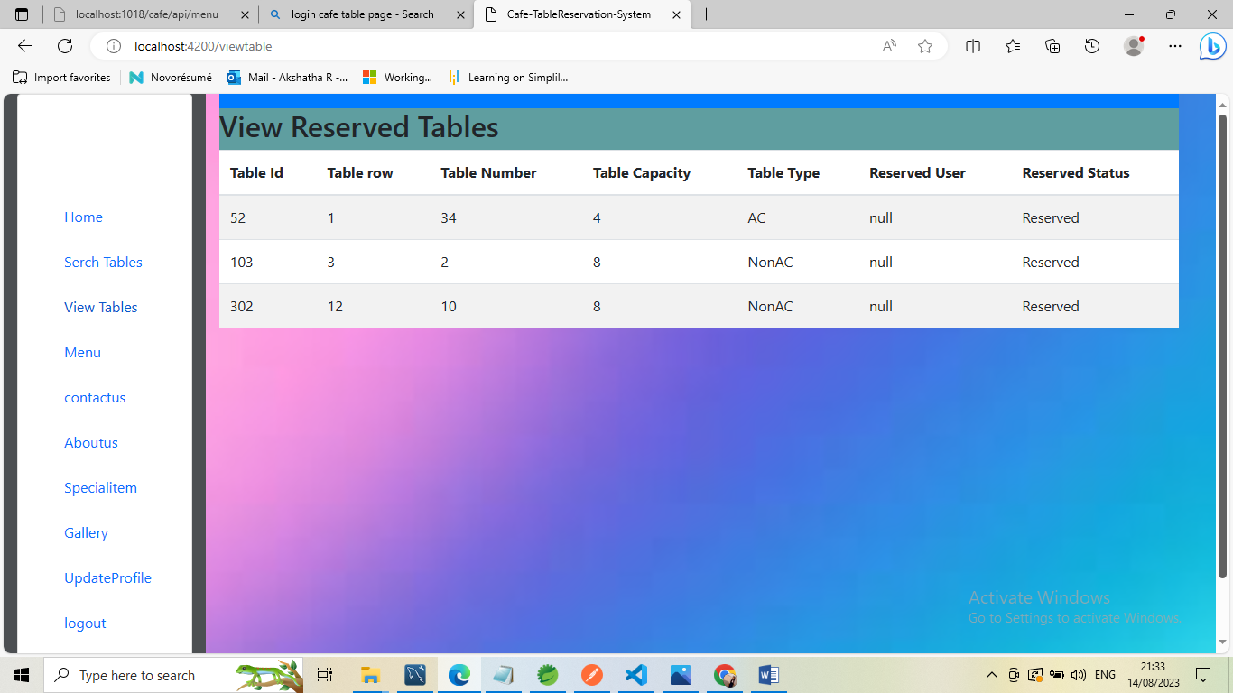

Slide 30

MENU MODULE
The Menu Module serves as the gateway to your system's diverse functionalities, offering an intuitive and organized navigation experience.
Seamlessly connecting users with the tools they need, this module simplifies access to key features and enhances overall user efficiency.
Make it easy for users to locate and access the functionalities they require.

Slide 31
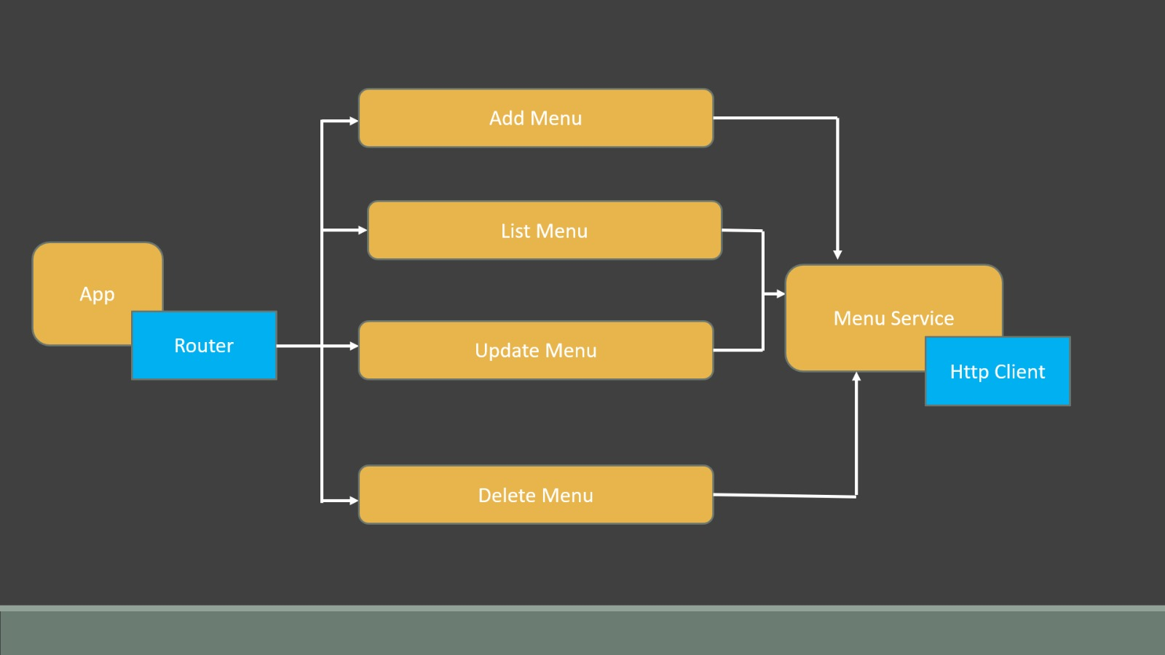

Slide 32
PROJECT DEVELOPMENT PROCESS
.List Menu Functionality
.Create Menu Functionality
.Search Menu Functionality
.Update Menu Functionality
.Delete Menu Functionality

Slide 33
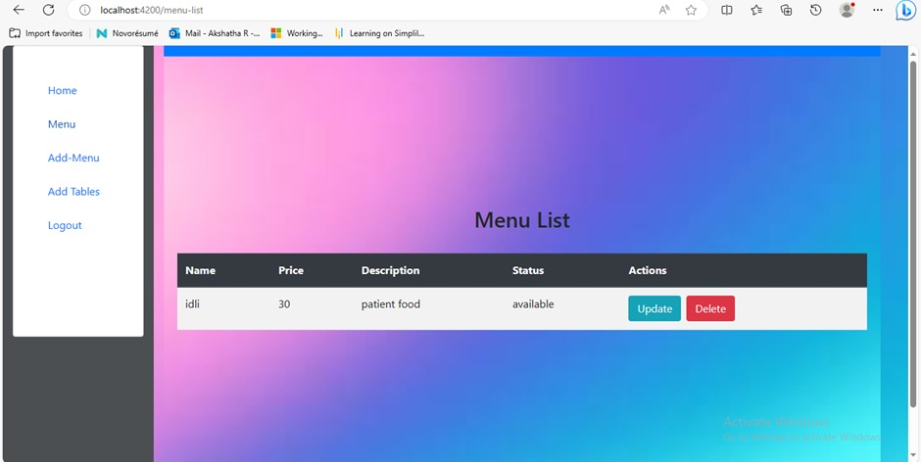

Slide 34
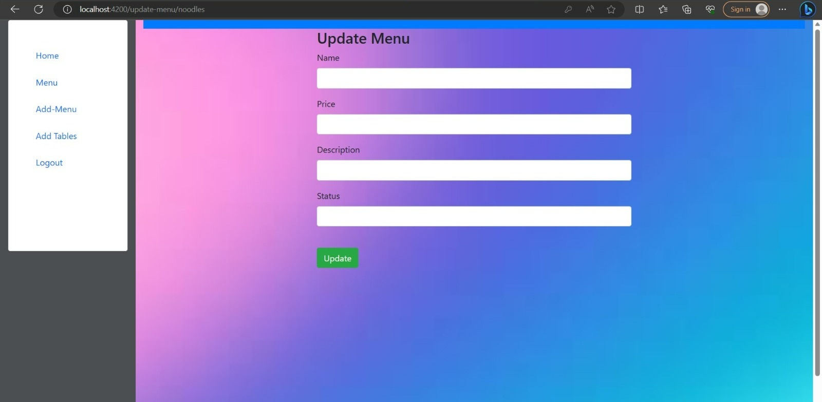

Slide 35
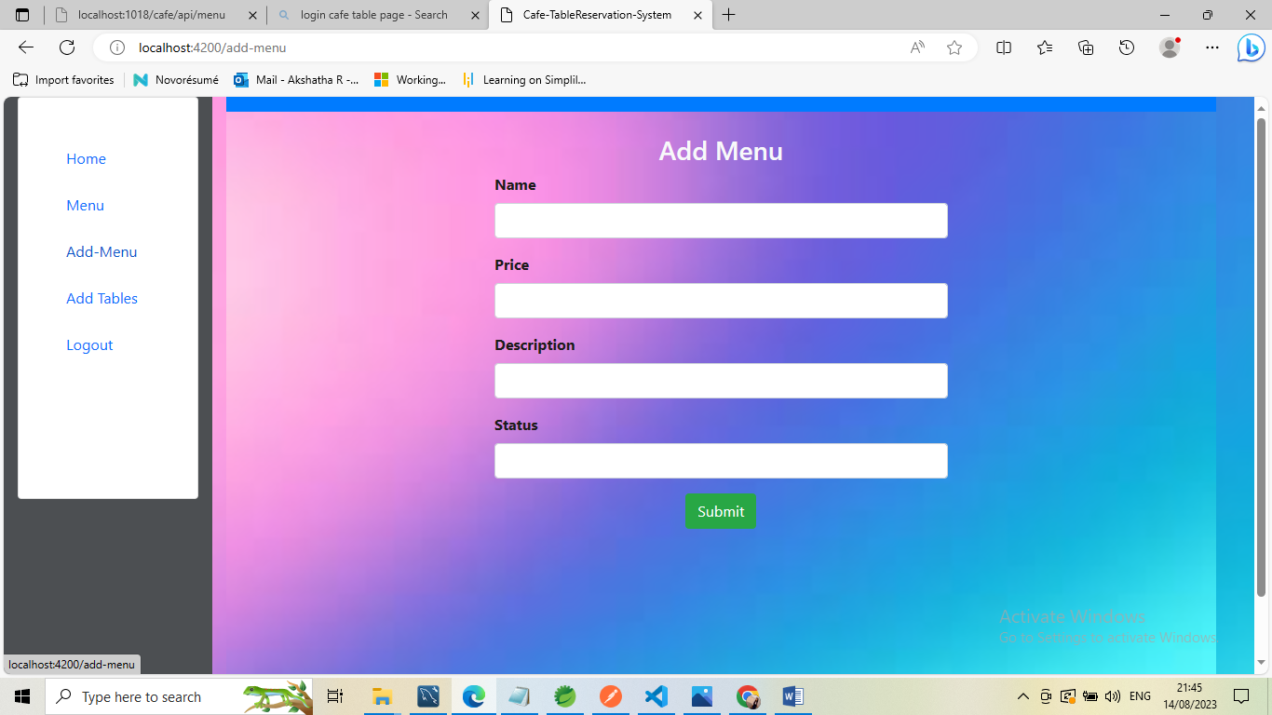

Slide 36
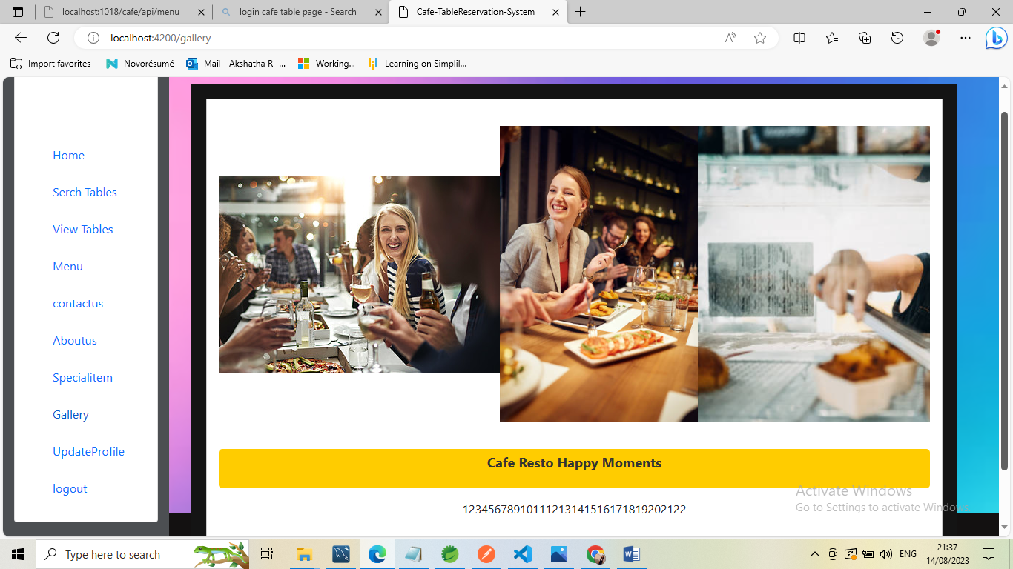

Slide 37
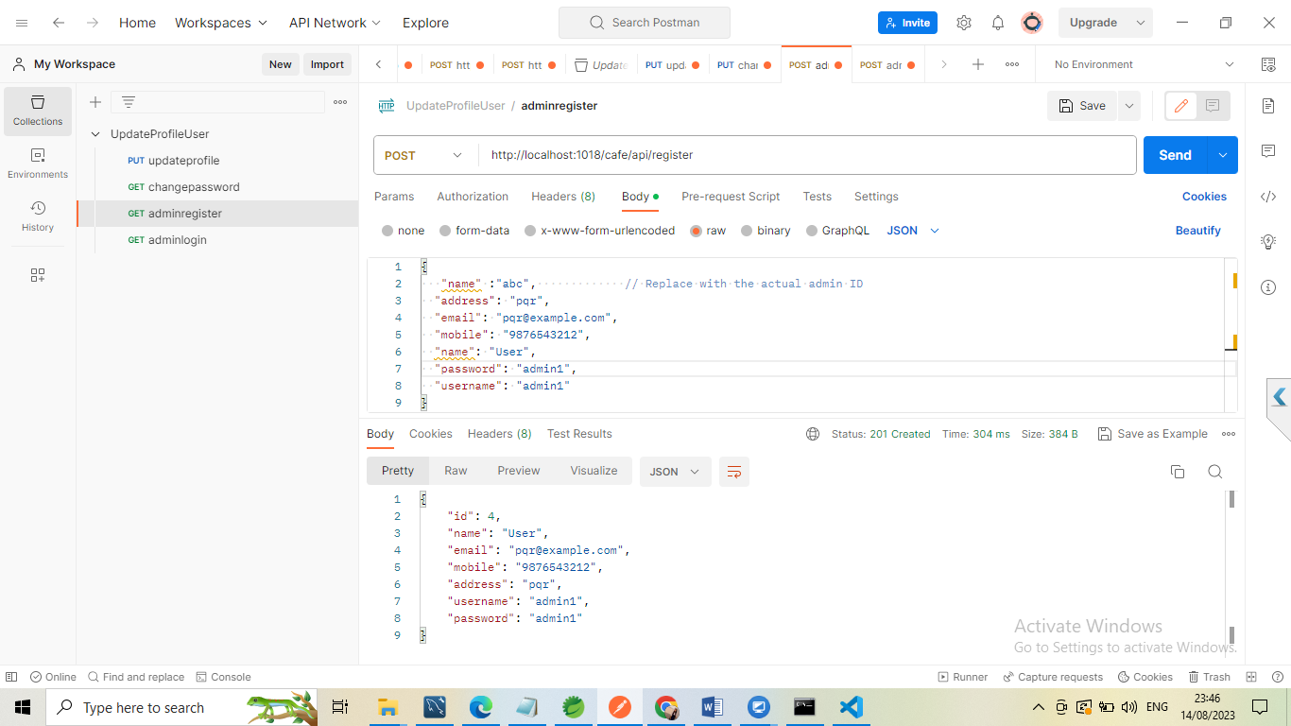
SAMPLE REST API OUTPUTS

Slide 38


Slide 39
FUTURE SCOPE
Mobile App Development
Online Payment Integration
Table Tracking and Analytics
Multi-Location Support
Integration with Delivery Services
Real-Time Updates

Slide 40
CONCLUSION
The project has concluded that if a customer is willing to visit any restaurant and finds no table is available for the meal
Then the customer has to wait long for the table availability. With the help of this application the customer can choose the desired table according to the location.
Keeping in view the demand of proposed project that gives a series of services and provides the customer to book a table and menu without waiting for a long time through an android application.
This application will get its importance as day by day people are getting into android and fast life.

Slide 41

THANK YOU

